Slide 1
Game of Life
A Simulation using MATLAB

Slide 2
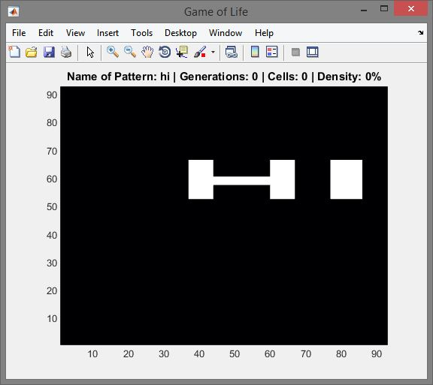
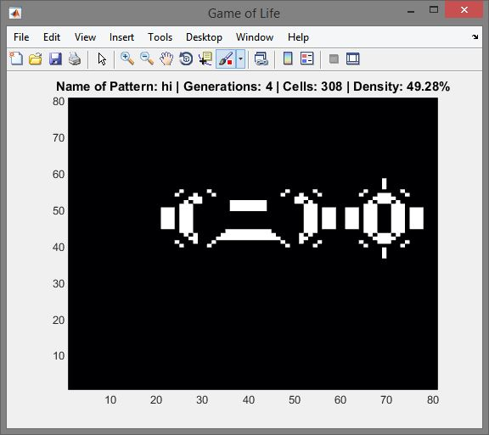
Not really a ‘Game’
0-player game
Initial states determine the next states

Slide 3









Rules
A cell can be alive or dead
Birth
Death
Survival

Slide 4
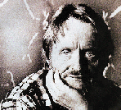
About Life
Invented in 1970 by John Horton Conway
John H. Conway is a professor of Finite Mathematics at Princeton University.
The rules were chosen such as to make it hard to tell whether a pattern will die out completely, form a stable population, or grow forever.

Slide 5
Why is it interesting?
Emergent complexity
study of how elaborate patterns and behaviors can emerge from very simple rules.
Simulate the real world?
Life is one of the simplest cellular automata to have been studied, but many others have been invented, often to simulate systems in the real world.

Slide 6




Patterns in life
Still Life Objects
Oscillators
Gliders
Other interesting patterns….

Slide 7
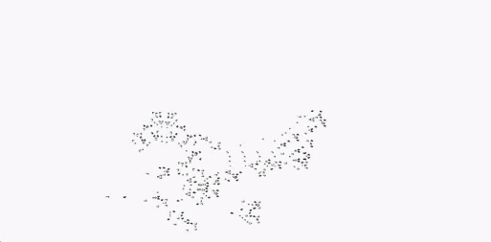
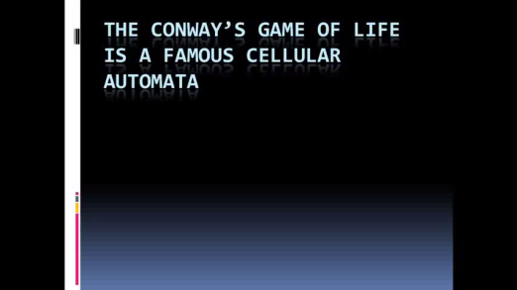
How Complex Can Life Get?
A computer can be built “with the right set of rules and enough space”
xkcd – a bunch of rocks
A prime number generator
A universal constructor – blueprint for reproduction

Slide 8
Applications
Generating multimedia content
Random Number generation and Cryptography
Modeling and simulation
Forest fires, Traffic, Gas particles, Life?
Artificial life
Computers

Slide 9
END

